Slide 1

Predicting Future Impacts from Plastic Waste on Oceans
A Predictive Analytics Approach to Reducing Ocean Plastic Pollution
Sarah Theriot

Slide 2
Introduction
Plastic Pollution Impact:
Growing environmental crisis, especially in oceans
Significant threats to marine life, ecosystems, and biodiversity
Business concerns: pressure from consumers, governments, and environmental groups
Objective:
Forecast plastic waste trends and encourage businesses to transition to reusable alternatives

Slide 3
Project Overview
Methodology
Predictive analytics using linear regression and time series forecasting
Dataset: Global Plastic Waste 2023
Variables analyzed: plastic consumption, recycling rates, waste management practices
Goal:
Provide insights into the future impacts of switching to sustainable products

Slide 4
Data & Evaluation Approach
Evaluation Metrics:
RMSE (Root Mean Square Error)
MAE (Mean Absolute Error)
Data Preparation:
Thorough data cleaning and exploratory analysis (EDA)
Ensuring dataset accuracy before analysis

Slide 5
Ethical Considerations
Data Integrity:
Ensure dataset accuracy to prevent misleading results
Potential bias from misreported or inaccurate data
Limitations:
Predictive models may not capture all variables (e.g., cultural practices, local policies)

Slide 6
Contingency Plan
Alternative Models:
If regression results are inadequate, use decision trees or random forests
Ensure flexibility to adjust methodology based on initial findings

Slide 7
Data Cleaning & Challenges
Data Cleaning Issues:
Standardizing country names, handling missing values
Merging datasets while resolving discrepancies
Adjustments:
Minor corrections made to ensure data integrity for accurate analysis

Slide 8
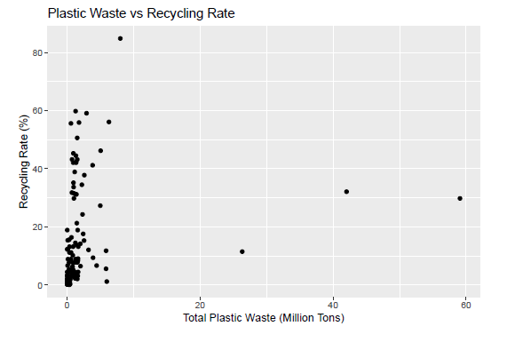
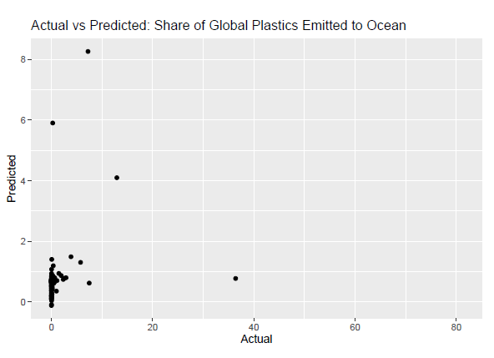
Preliminary Analysis
Visualizations:
Scatterplots: Relationship between plastic consumption and recycling rates
Time Series: Projected trends in plastic waste production
Key Insight:
Initial data exploration reveals some key trends and correlations for further analysis

Slide 9
First Results
Linear Regression Results:
R-squared: 0.06472 (limited explanatory power)
Positive correlation: Total plastic waste increases mismanaged waste
Recycling rates not statistically significant in reducing mismanaged waste

Slide 10
Limitations of the Analysis
Model Limitations:
Low R-squared value suggests missing explanatory factors
Missing data and cross-sectional nature limit insights
Need for additional data or longitudinal studies

Slide 11
Suggestions for Future Research
Next Steps:
Include economic development, government policies, and public awareness factors
Consider longitudinal studies to track trends over time
Explore region-specific approaches to waste management

Slide 12
Conclusion
Key Takeaways:
Total plastic waste directly impacts mismanagement
Recycling efforts alone are insufficient to address the issue
A comprehensive approach is required, including stronger waste management systems and public engagement
Next Steps:
Further analysis and research into global plastic waste solutions

Slide 13
Questions
Thank you for your attention!
For further questions please submit them to my email.

